Slide 1

ABES Engineering College
Course Title: Fundamentals of Linear Algebra & Statistics

Slide 2
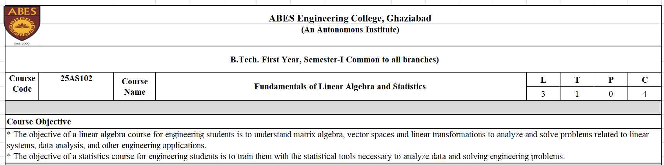

Slide 3
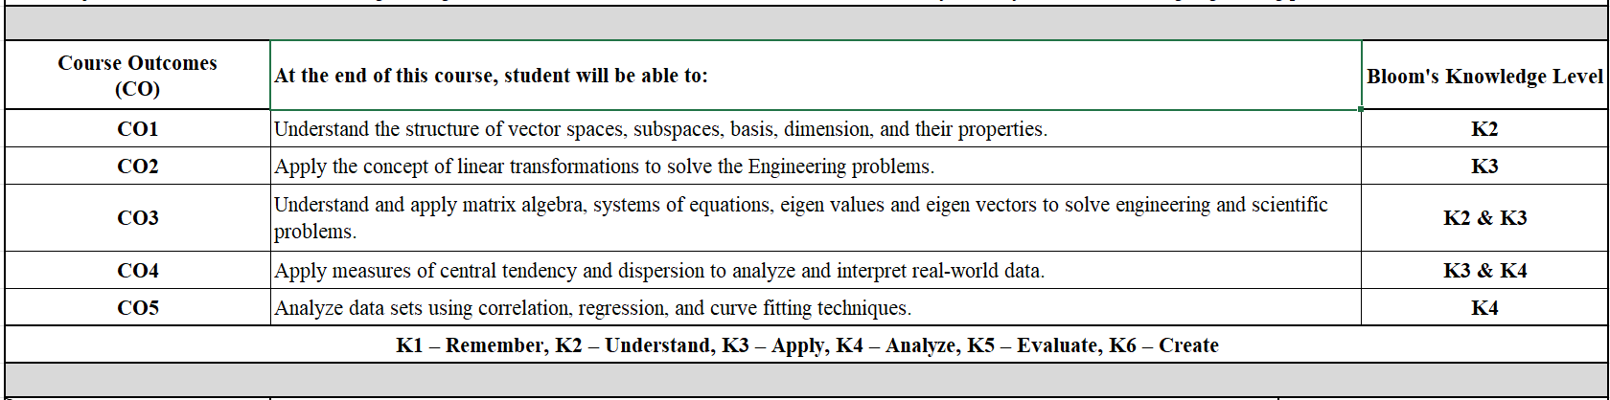

Slide 4
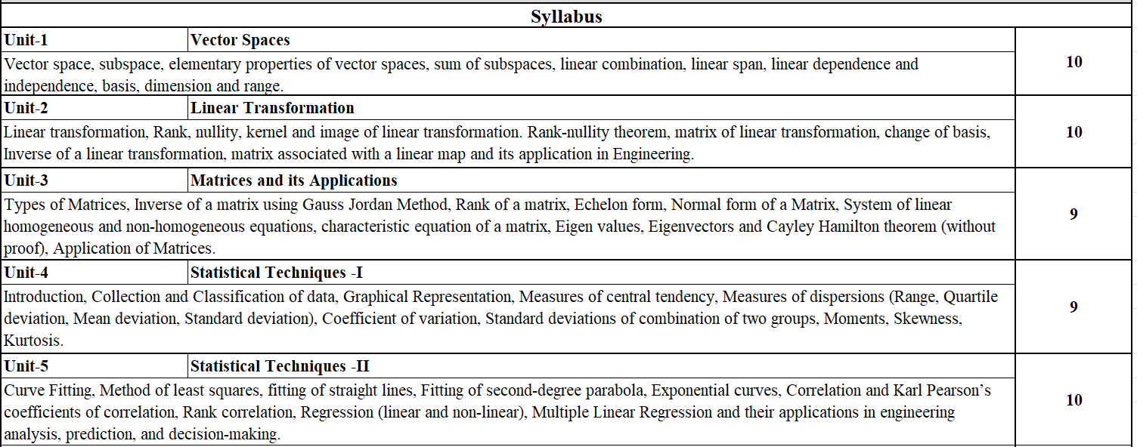

Slide 5
Text Books 1. Singh and Pundir, Linera Algebra and Matrices, A Pragati Edition 2. David C. Lay, Steven R. Lay, Linera Algebra and its applications, Pearson. 3. S. P. Gupta, Statistical Methods, Sultan Chand & Sons 46th edition
Reference books
1. Schaum Series, Outline of Linear Algebra, 4th edition.
2. K. Hoffman and R. Kunze, Linear Algebra 2nd Ed., Prentice Hall of
India, 2015.
3. V. Krishnamurthy, V. P. Mainra and J. L. Arora, An introduction to
Linear Algebra, Affiliated East-West, 1976.
4. Stephen H. Friedberg, Linear Algebra, PHI, Fourth Edition
5. Wackerly, Dennis D., Mendenhall III, William & Scheaffer, Richard L.
Mathematical Statistics with Applications. Cengage Learning.

Slide 6
Why Linear Algebra ?
Linear algebra is essential because it provides powerful tools to model and solve complex problems across science, engineering, computer graphics, and data science. It focuses on vectors, vector spaces, and linear transformations, which offer both algebraic and geometric perspectives to simplify analysis and allow for efficient computation. Key applications include creating machine learning algorithms, animating computer graphics, analyzing systems of equations, and understanding natural phenomena.

Slide 7
Core Concepts and Tools
Vectors and Vector Spaces:
Linear algebra studies vectors, which can represent quantities like position, velocity, or even complex data points. Vector spaces provide a structured framework for these vectors and their operations.
Matrices and Linear Transformations:
Matrices are used to represent linear transformations, which are functions that map vectors to other vectors while preserving straight lines and the origin.
Systems of Linear Equations:
Linear algebra provides methods to solve sets of interconnected linear equations, which are common in many scientific and engineering models.

Slide 8
Why It Matters for Your Career
Data-Driven Roles:
Proficiency in linear algebra is becoming a prerequisite for many roles in data science, machine learning engineering, and AI.
Foundation for Advanced Topics:
It's a foundational subject for more advanced mathematical concepts and their applications, making it a critical skill to build upon.
Problem-Solving:
It provides systematic ways to translate real-world problems into solvable mathematical models, fostering independent and logical thinking.

Slide 9
Why Statistics ?
Statistics is essential because it provides the methods and techniques to collect, analyze, interpret, and present data, which allows for informed decision-making, understanding complex patterns, and solving problems across virtually all fields, from personal choices to scientific research and business strategies. It enhances critical thinking, enables accurate predictions, helps to prevent misleading information, and opens up career opportunities in our data-driven world.

Slide 10
Core Concepts and Tools
Informed Decision-Making:
Statistics help organizations and governments track progress, measure performance, analyze problems, and make data-backed decisions, such as where to build a new hospital based on population data.
Personal Choices:
Statistics provide the tools for understanding and interpreting data in everyday life, allowing individuals to make more informed choices based on evidence.
Critical Thinking and Data Literacy
Statistics trains you to think critically about data, recognize potential biases, and question the validity of claims presented with statistics.

Slide 11
Why It Matters for Your Career
Career and Future Opportunities:
Proficiency in statistics is a valuable skill in today's information age, leading to numerous career opportunities in fields that involve data analysis.
Statistics provide the tools for understanding and interpreting data in everyday life, allowing individuals to make more informed choices based on evidence.
Statistics provides the tools and methodologies for various professions, including those in medicine, psychology, economics, and social sciences.

Slide 12
Thank you

